Slide 1

Make Friends with the Clang Static Analysis Tools
Gabor Horvath

Slide 2
outline
What is static analysis? What it is good for? Why is it hard?
How does it work?
What open source tools are available?
How to integrate them into the workflow?
How to write static analysis friendly code?

Slide 3
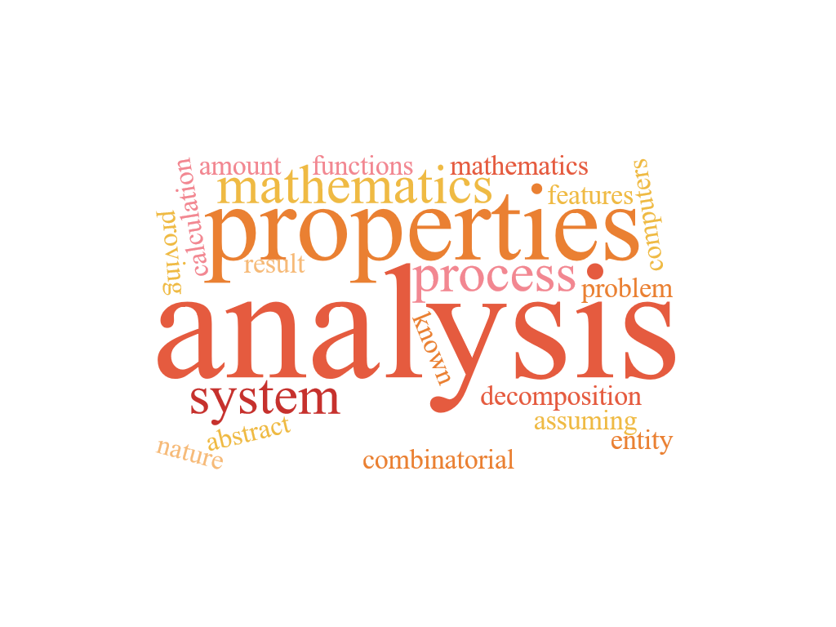
Static analysis
Analyze the code without execution
Optimization
Code Transformation
Bug finding
Verification
Visualization
Metrics
…

Slide 4

Static analysis
Answer questions about the code
Terminates?
Maximum heap size?
What is the output for a given input?
Can this pointer be null?
During development we do a fair amount of static analysis manually!

Slide 5

Halting problem
Does a program terminate on a given input?
Undecidable!
Rice’s theorem from ‘53:
Every interesting question about a program is undecidable!
int x = 5;
if (program p halts on input i)
++x;

Slide 6

Approximation
Cannot solve undecidable problems
We can approximate, employ heuristics
False positives (false reports)
False negatives (unreported errors)
Verification: eliminate false negatives
Industrial use: reduce false positives

Slide 7
Why bother with static analysis?
No execution required
Works when code coverage is suboptimal
Works when the runtime environment is not available
Enforce coding guidelines more rigorously
Cheap supplement to testing
Find bugs early in the development cycle 󠅉→ cheaper to fix

Slide 8
Analyzing C++ is hard
The compilation model implies a lot of reparsing!
Modules to the rescue?
Type information required for parsing
Parsing and semantic analysis cannot be split
Macros make it hard to do semantics preserving rewrites or caching representations of code in header files!
T * t;
S (x);
f((R)*x);

Slide 9
Static analysis methods
Textual pattern matching – CppCheck
Matching the Syntax Tree – CppCheck, Clang Tidy
Flow sensitive algorithms – Some compiler warnings
Path sensitive algorithms – Clang Static Analyzer

Slide 10
Textual pattern matching
Transform code to canonical form
Match patterns on the transformed code
#define M 0
int a = 5 / M;
int b = getValue();
if (b == 4) {
...
int c = 5 / (b – 4);
}
Token::Match(tok, “ / 0”);

Slide 11
Matching the syntax tree
FunctionDecl main
`-CompoundStmt
|-DeclStmt
| `-VarDecl d 'double *'
|-BinaryOperator '='
|-DeclRefExpr 'double *' 'd'
`-CStyleCastExpr 'double *'
`-CallExpr
|-ImplicitCastExpr
| `-DeclRefExpr 'malloc'
`-ImplicitCastExpr 'int'
`-UnaryExprOrTypeTraitExpr sizeof
`-ParenExpr
`-DeclRefExpr 'double *' 'd'
int main(){
double *d;
d=(double*)malloc(sizeof(d));
}
Type information is available
Typedefs, overloads, templates are resolved

Slide 12
Flow sensitive algorithms
Unknown
Nonzero
Zero
Walk on the control flow graph
What to do on merge points? (Lattice)
X = 0
int x = 0;
if (z) {
x = 5;
}
if (z) {
y = 10 / x;
}
X = Nonzero
X = 0
X = 0
X = 0
Division by zero FALSE POSITIVE

Slide 13
Flow sensitive algorithms
Unknown
Zero
Polynomial but imprecise
Nonzero
X = 0
int x = 0;
if (z) {
x = 5;
}
if (!z) {
y = 10 / x;
}
X = Nonzero
X = 0
X = Nonzero
X = Nonzero
X = Nonzero FALSE NEGATIVE

Slide 14
Path sensitive algorithms
Path sensitive walk over the control flow graph
Simulated execution
Try to enumerate every possible execution path
Symbols to represent unknown values
Record constraints on symbols for a path
Prune impossible paths
Exponential in the branching factor

Slide 15

Symbolic execution
b: $b
switch(b)
default
case 4
case 1
void test(int b) {
int a,c;
switch (b){
case 1: a = b / 0; break;
case 4: c = b - 4;
a = b / c; break;
}
}
b: $b
b: $b
b: $b
$b=[MIN_INT,0],[2,3],[5,MAX_INT]
$b=[1,1]
$b=[4,4]
a = b/0;
c = b-4;
b: $b
b: $b
c: 0
$b=[4,4]
Nodes are immutable states, arrows are transitions.
a = b/c;
b: $b
c: 0
$b=[4,4]

Slide 16
Modeling memory
Stack Region
A a[10];
a[5].f
What about aliasing?
What about the memory hierarchy?
What about locality?
Array Region
Element Region
Element Region
Element Region
Field region

Slide 17
Context sensitivity (INTRa/interprocedural)
int getNull(int a) {
return a?0:1;
}
void test(int b)
{
int a;
switch (b) {
...
case 5:
a = b / getNull(b);
break;
...
}
}
Called with a == 5, returns 0
Division by zero

Slide 18
Cross translation unit analysis
A.cpp
B.cpp
void f(int *x);
void g(int *x) {
if (*x > 0) {
f(x);
f(x);
}
}
*x is positive
void f(int *x) {
*x = -(*x);
}
*x is unknown

Slide 19
Global analysis
If cross translation unit analysis works, what about other modules?
What about other projects/libraries?
What about the closed source libraries?
It is likely to have a boundary to unknown

Slide 20
Summary based analysis
One way to implement interprocedural analysis
Summarize some information about a function
What summarization means depends on the actual analysis
Instead of “inlining” the function call, use a summary
Alternatively, use summary when the function body is not available

Slide 21
Open source tools
CppCheck
CppLint
Clang Static Analyzer
Clang Tidy
…
}

Slide 22
Clang static analyzer
Path sensitive
Symbolic execution
Good memory modeling capabilities
Context sensitive
Lacks cross translation unit analysis support

Slide 23
Clang tidy
Supports code rewriting
Large amount of checks (and growing fast)
Most checkers are based on syntax tree matching
Lacks cross translation unit analysis support
C++ Core Guideline checks

Slide 24
How to integrate into the workflow?
Old and huge projects
New commits should not introduce new reports
Most severe reports should be fixed gradually
Green field projects
Keep the number of reports minimal (ideally 0)
Integrate into the CI, commit hooks

Slide 25
How to integrate into the workflow?
Incremental analysis locally
Build system support?
Full analysis every night
Triaging (critical, non-critical, false positive, fixed, …)
False positive suppression
Skip uninteresting files (maintained by other team, etc…)
Easy to use

Slide 26
Codechecker
Open source tool to support the workflow using static analyzers
Clang Static Analyzer and Clang Tidy supported
Developed by Ericsson, might end up under the LLVM umbrella
Actively developed
Supports Mac and Linux
How does this work? See the EuroLLVM 2015 talk!
http://llvm.org/devmtg/2015-04/

Slide 27
codechecker
Web viewer for defects
Filtering, false positive suppression
Differential view (what are the new reports compared to a baseline?)
Incremental analysis
Command line client for CI system integration
Eclipse integration
CodeCompass integration (Lightning talk tomorrow!)

Slide 28
How to use codechecker?
Install instructions are detailed on the GitHub page
Run the check:
$> CodeChecker check -n FirstCheck -b "make"
Start the webserver (previous command prints this):
$> CodeChecker server -w ~/.codechecker

Slide 29
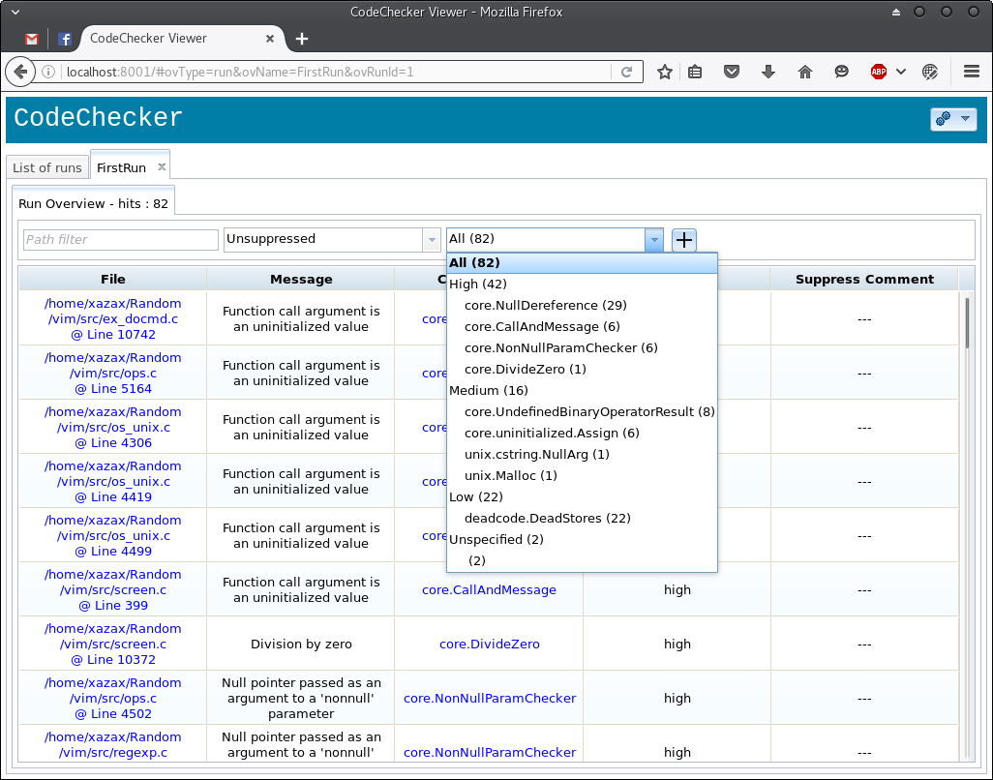

Slide 30
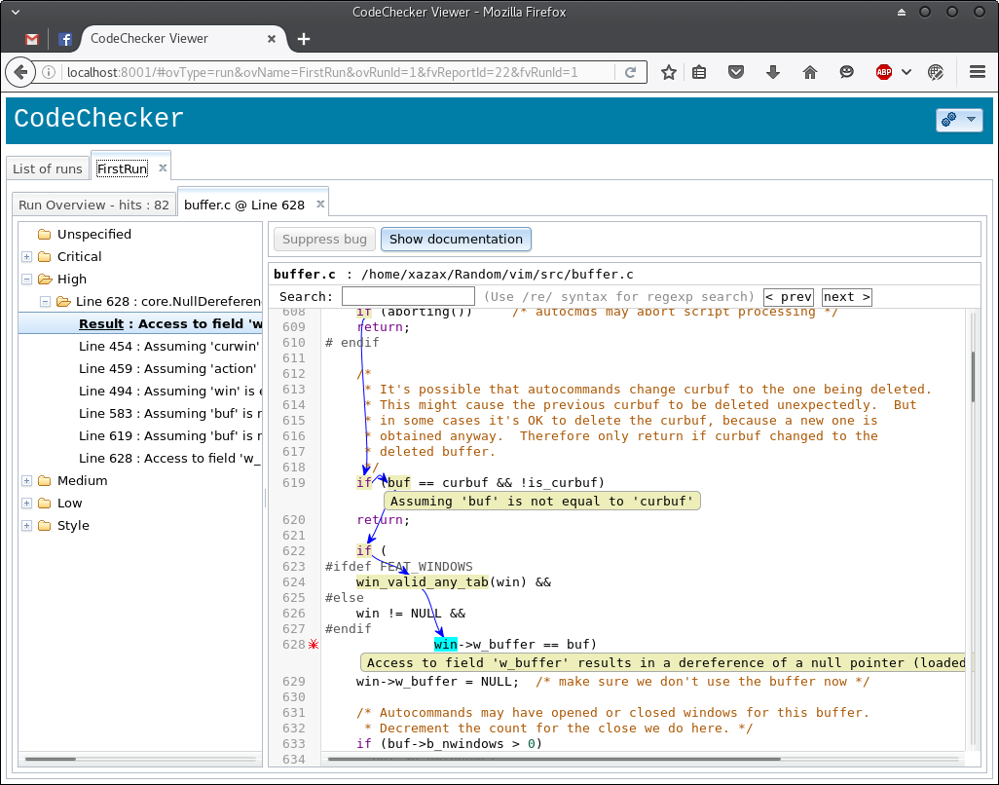

Slide 31
How to use codechecker?
The analysis run name should be:
New and unique for clean build (e.g. nightly on CI)
Name of an existing run for incremental check (e.g.: on local machine)
The web viewer is localhost only by default
For differential view, the baseline should be selected first

Slide 32
Writing static analysis friendly code
Minimize macro use
Avoid nonstandard extensions, ensure generated code is warning free
Use plenty of types (type based alias analysis, …)
Guarantees from the type system are always better than relying on 3rd party static analysis tools
Do not overuse references, pointers

Slide 33
Writing static analysis friendly code
Use annotations! (noreturn, deprecated, nullability, …)
Very important to annotate custom assertion functions!
Users benefit from annotations in library headers
Always analyze the debug build!
Asserts help the analyzer to understand the code
Avoid arcane build systems!

Slide 34
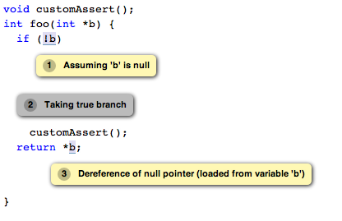
Writing static analysis friendly code

Slide 35
Handling false positives
False positives?
Impossible path
Invariant unknown to the analyzer
Help the analyzer understanding your code
Add asserts, rewrite code snippets (e.g.: making an implicit cast explicit)
Prefer widely used APIs to your custom solution (Standard C API, Posix, STL)
Increase the coverage, a report can halt the analysis on a path
Helps readability

Slide 36
Handling false positives
Do NOT turn off core checkers to suppress warnings!
Preprocess instead (or use CodeChecker)
Exclude problematic code using macros
Use false positive suppression only as a final resort
Comment! Why is it false positive? Why is it not possible to change the code? What are the requirements to remove this suppression? In case of an analyzer bug, link to the bug report!
Do NOT mark 3rd party headers as system headers
Use post processing to remove these reports (or use CodeChecker)

Slide 37
conclusion
Static analysis is useful to have in the workflow
There are several powerful tools available for free
Writing static analysis friendly code requires some effort, but worth it
Library devs should pay attention to static analysis

Slide 38
references
CodeChecker: https://github.com/Ericsson/codechecker
CodeChecker Eclipse plugin: https://github.com/Ericsson/CodeCheckerEclipsePlugin
CodeCompass: https://github.com/Ericsson/CodeCompass
C++ Core Guidelines: https://github.com/isocpp/CppCoreGuidelines

